Slide 1

Telematics Exercise Nationwide HPC Data Science Internship
October 26, 2020
MJ Sarfi

Slide 2
Part 1 – GPS Data Analysis

Slide 3
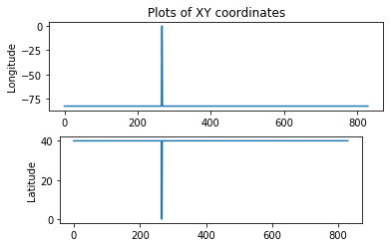
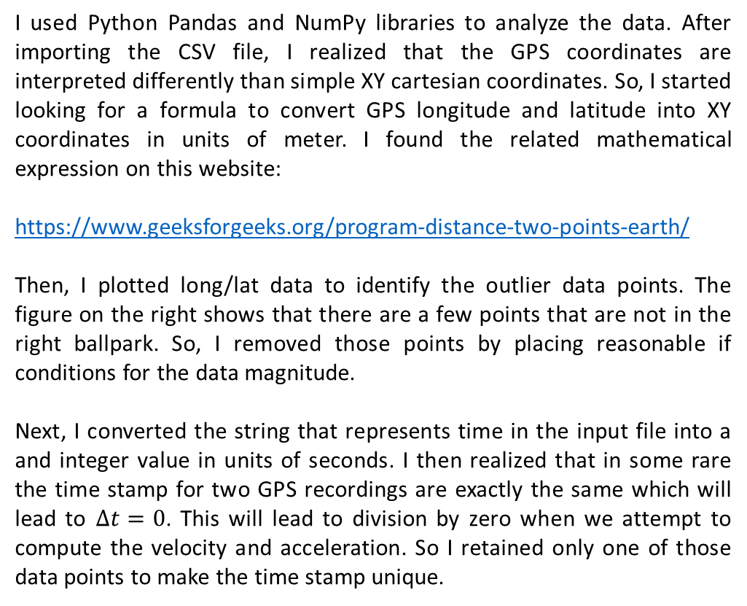
Steps taken for Data Cleaning
I used Python Pandas and NumPy libraries to analyze the data. After importing the CSV file, I realized that the GPS coordinates are interpreted differently than simple XY cartesian coordinates. So, I started looking for a formula to convert GPS longitude and latitude into XY coordinates in units of meter. I found the related mathematical expression on this website:
https://www.geeksforgeeks.org/program-distance-two-points-earth/
Then, I plotted long/lat data to identify the outlier data points. The figure on the right shows that there are a few points that are not in the right ballpark. So, I removed those points by placing reasonable if conditions for the data magnitude.
Next, I converted the string that represents time in the input file into a and integer value in units of seconds. I then realized that in some rare the time stamp for two GPS recordings are exactly the same which will lead to $∆t=0$. This will lead to division by zero when we attempt to compute the velocity and acceleration. So I retained only one of those data points to make the time stamp unique.

Slide 4
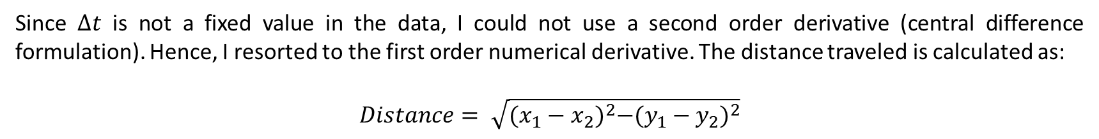
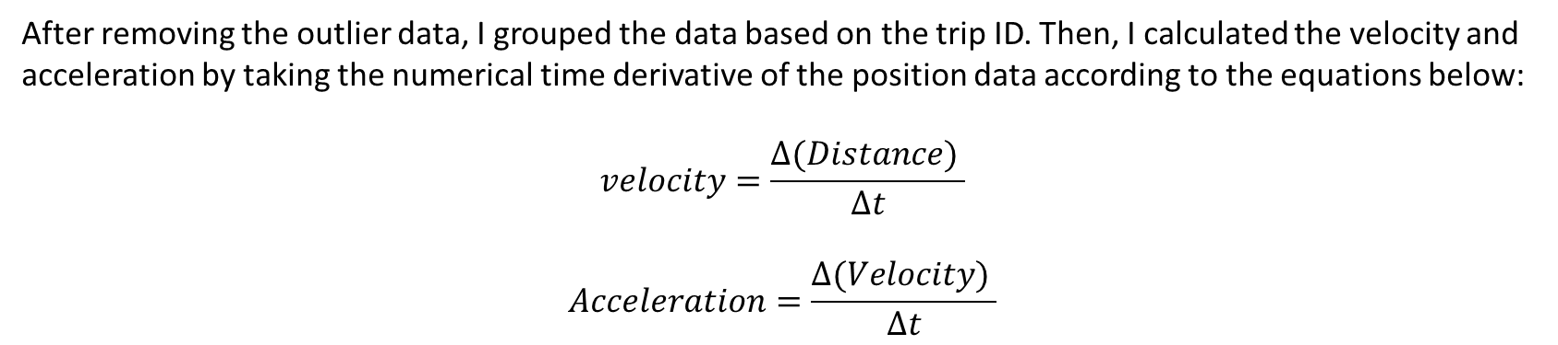
Steps taken for Data Cleaning
After removing the outlier data, I grouped the data based on the trip ID. Then, I calculated the velocity and acceleration by taking the numerical time derivative of the position data according to the equations below:
$$velocity=\frac{∆(Distance) }{∆t}$$
$$Acceleration=\frac{∆(Velocity) }{∆t}$$
Since $∆t$ is not a fixed value in the data, I could not use a second order derivative (central difference formulation). Hence, I resorted to the first order numerical derivative. The distance traveled is calculated as:
$$Distance= \sqrt{{(x_{1}−x_{2})}^{2}−{(y_{1}−y_{2})}^{2}}$$

Slide 5
Threshold for hard events
Thresholds for the accelerometer values need to be selected carefully. If the threshold is too low, many safe events will be identified as dangerous. If the threshold is too high, the available data will not be used to its full potential and true dangerous driving events will not be detected. In addition to that, the expected “safe” accelerations will differ based on the vehicle. We are assuming here that the vehicle here was a passenger car.
The threshold for hard braking and hard acceleration was taken from these references:
European patent application: Method for detecting harsh driving operations of a vehicle and system for monitoring the
driving conditions of a vehicle
https://www.geotab.com/blog/what-is-g-force/
Hard braking threshold = -6.1G & hard acceleration threshold = +4.01G
The detection of harsh driving operations is only carried out if the vehicle is travelling at a speed greater than a minimum threshold speed (for example 5 m/s), below which the detection of speed and direction by the GPS positioning system is no longer reliable and it certainly would not seem appropriate to talk of a "harsh" operation.
There is another type of hard event, known as hard cornering, which involvs the rotational acceleration of the vehicle. It is not considered in this study.

Slide 6
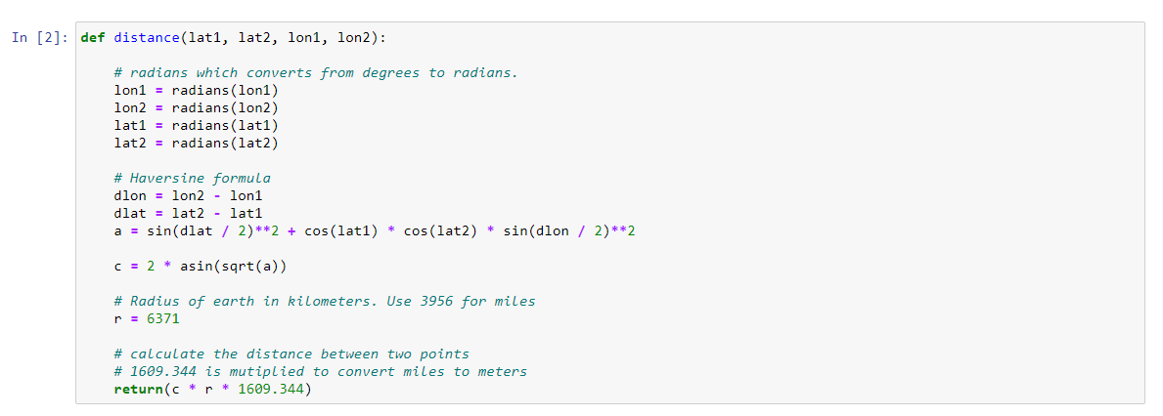
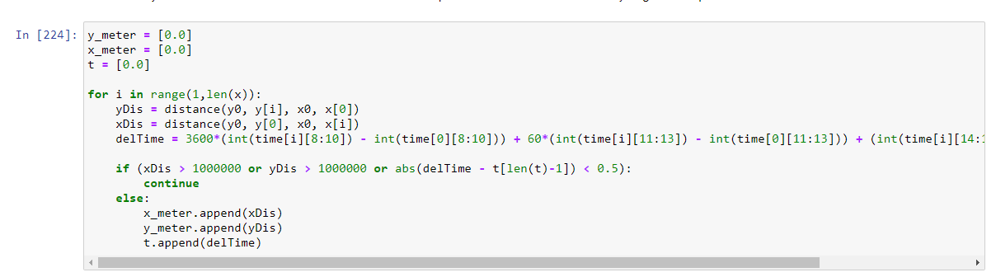
My code and thought process
This function takes two sets of longitude and latitude values in GPD coordinates and returns the distance between the points in meters
If the distance is too large -> remove the outlier data
Convert the time data from string to integer (seconds) and compute time difference

Slide 7
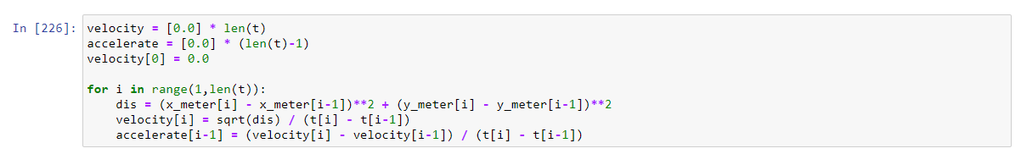
Summary of each trip
There are 16 trips recorded in this data file. I will present the path trajectory, plot of acceleration and velocity, harsh events, distance traveled and the idle time.
The first point in each trip is given (0, 0) coordinates as the origin.
The idle time has been calculated as the total amount of time that the vehicle velocity is less than 0.5 m/s.
Calculate acceleration and velocity by taking the numerical derivative $f^{′}\left(x\right)=\frac{f\left(t+∆t\right)−f(t)}{∆t}$

Slide 8
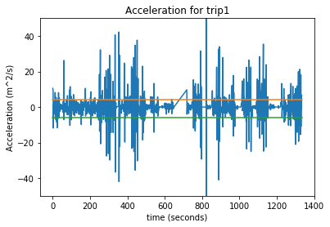
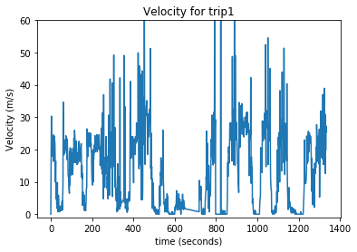
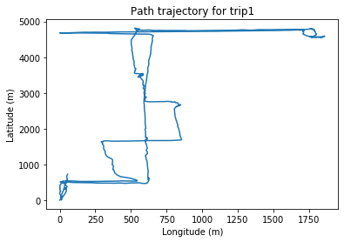

Trip #1 summery

Slide 9
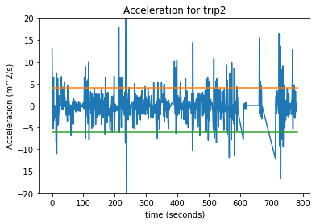
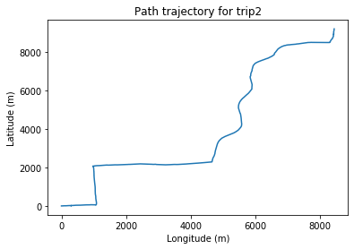
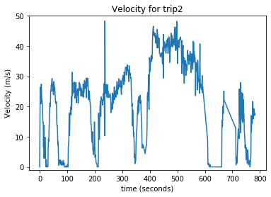

Trip #2 summery

Slide 10
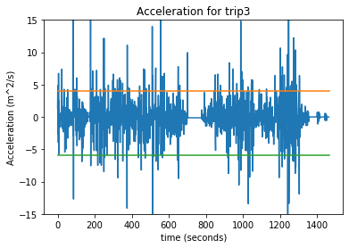
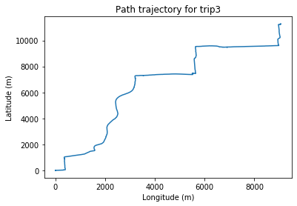
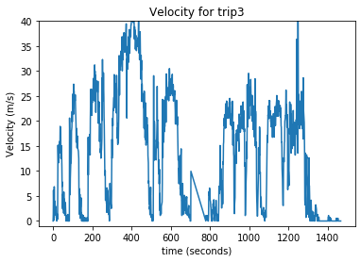

Trip #3 summery

Slide 11
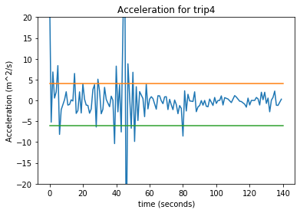
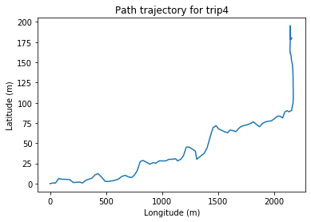
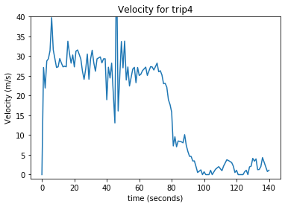

Trip #4 summery

Slide 12
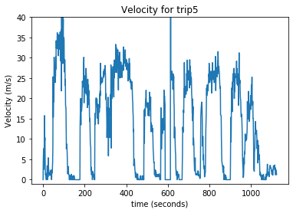
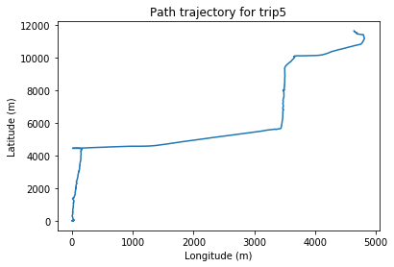
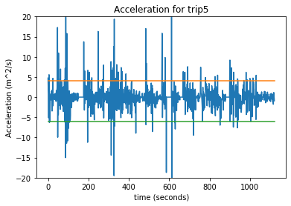

Trip #5 summery

Slide 13
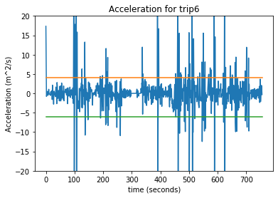
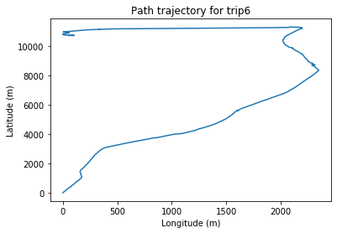
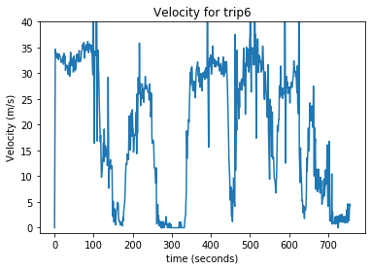

Trip #6 summery

Slide 14
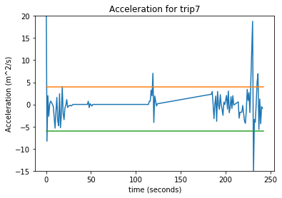
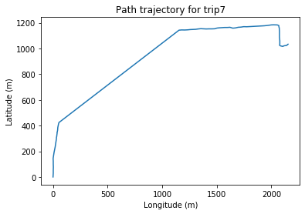
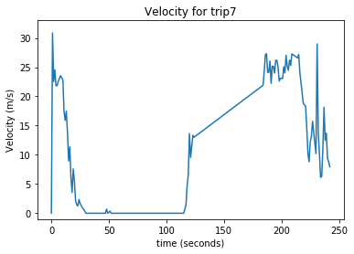

Trip #7 summery

Slide 15
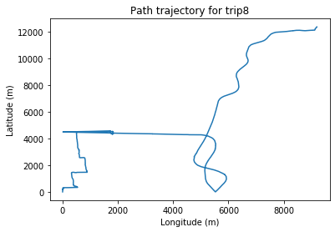
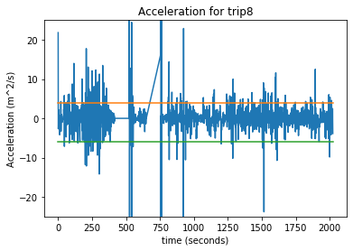
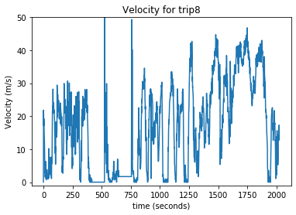

Trip #8 summery

Slide 16
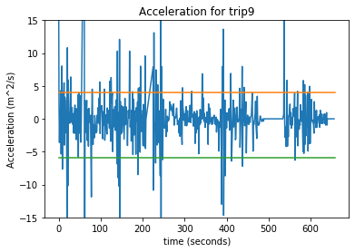
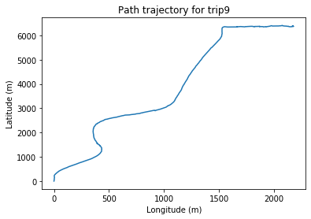
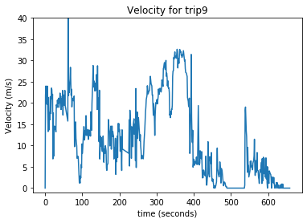

Trip #9 summery

Slide 17
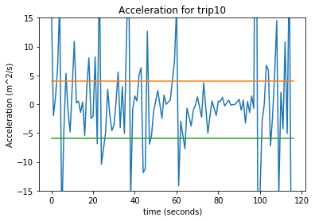
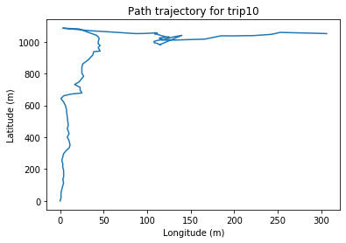
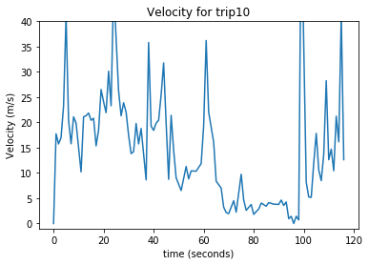

Trip #10 summery

Slide 18
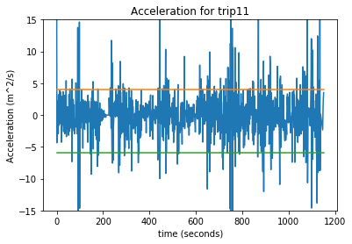
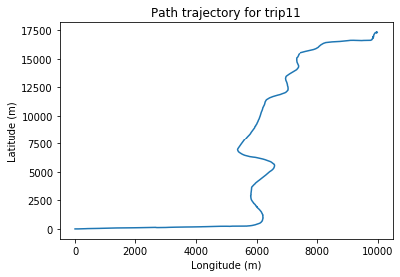
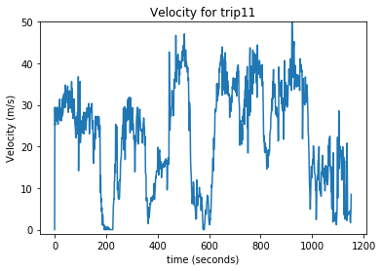

Trip #11 summery

Slide 19
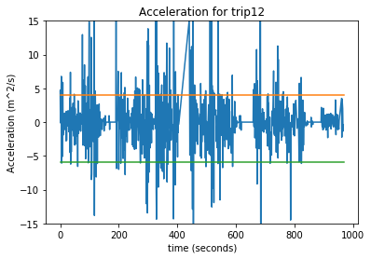
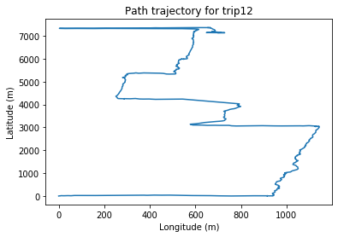
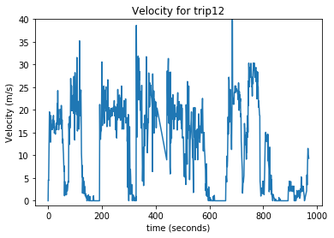

Trip #12 summery

Slide 20
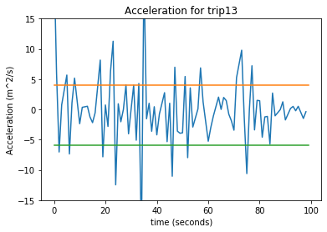
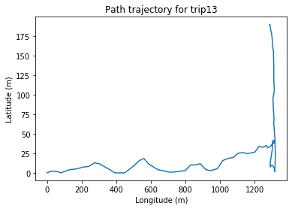
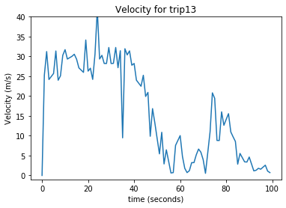

Trip #13 summery

Slide 21
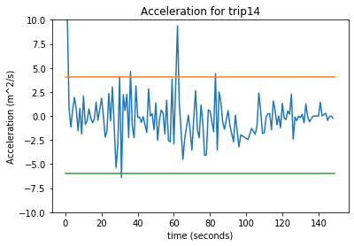
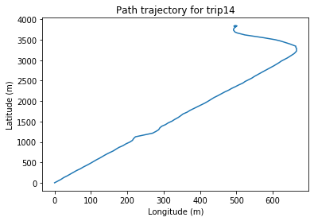
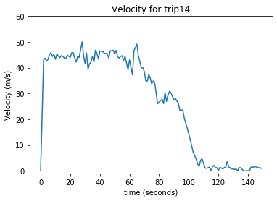

Trip #14 summery

Slide 22
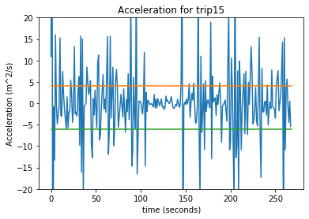



Trip #15 summery

Slide 23




Trip #16 summery

Slide 24





Proposed Big Data Framework
Obviously, a data set that has 50 million rows is hard to be analyzed using traditional methods due to its shear size. Therefore, I suggest to use Hadoop Ecosystem in order to process this large data set in parallel. It is economical because it is free of cost and you can use ordinary computers for running Hadoop as opposed to buying super computing clusters. Also, Hadoop is easily scalable (can follow horizontal and vertical scaling). In contrast to traditional methods, Hadoop distributes the data between multiple computers and then runs the computations wherever the data is located.
Hadoop is comprised of several components such as, Spark, HDFS, Pig, Hive, Sqoop, as discussed below:
Distributes data among processors
Sqoop reads the data in relational format, such as *.csv or MySQL, and stores in a non-relational format, suitable for distributes storage.
Takes the data from Sqoop and stores it in HDFS
In HBase a table can have thousands of columns
An open-source cluster computing framework
Has ML and batch processing libraries
Used for structure data analytics

Slide 25
Big data processing with Hadoop
The following sequential framework is typically used for analyzing a large set of data.
Ingest
Processing
Analyze
Access
Sqoop transfers the data from relational format (RDBMS) into HDFS so that it can then be distributed
Data is stored in distributed file system (HDFS or Hbase)
Spark and MapRedue analyze the data the similar to how it was analyzed by Python in this project
Since we are dealing with structured data, we use Hive to analyze the data
The analyzed data can be accessed by the user for creating charts and plots
HUE is a web interface, whereas Cloudera Search provides a text editor for exploring data

Slide 26
Part 2 – Modeling

Slide 27

Thought process in my code
After importing the data from the *.csv file, I plotted histogram charts as shown below in order to get a sense of the distribution of all variables and see if there are any outlier data.
It is obvious that Hard Brakes and Hard Acceleration data contains some very large values that are out of range. I removed these data points because their existence will adversely affect our predictive model.

Slide 28

Thought process in my code
After removing the hard event data points that have a value larger than 1500, I got the following histograms that are much smoother and sensible that the previous figure.

Slide 29

Effect of car type on Loss
In order to assess the effect of car type on the loss outcome, I grouped the original data set (after removing the outlier data points) based on the car type as show below. This will separate different car types, such as SUV, etc. from each other. I also computed the mean value of Loss for every car category in the following line of code. I plotted a bar chart, showing the mean value of loss for each car type.
One can draw the conclusion from the figure on the right that there is no significant difference between car types with respect to Loss because, at least visually, it is obvious that all the bars have roughly the same height.

Slide 30

Effect of hard brakes and hard accelerations on Loss
To answer this question, I evaluated the correlation between hard accelerations and loss as well as the correlation between hard brakes and loss. The following figure displays that part of my code.
The above numbers show that the correlation of hard brakes and acceleration with loss is both minimal since their values are much smaller than 1. However, hard accelerations shave a higher correlation with loss compared to hard brakes, because 0.072 > 0.01. That means that hard acceleration is more important than hard brakes.

Slide 31

Assumption in building the model
In order to make a binary classification model for the loss, I first removed the variables that are significant. For example, the number of days for all the cars is equal to 365. Also, the vehicle column is just an index number. In addition, I showed that the vehicle type has no significant bearing on the loss value. So, I dropped these three columns from the data set. Please note that I had already removed the data points that had outlier values.
I then plotted a multicollinearity heat map that shows the correlation of the remaining variables. Apparently, distance has the highest correlation with loss, which makes sense, because the more a vehicle is driven, it is more likely to have an accident on the road.
Also, the higher positive correlation between the driven distance and the number of hard events make sense too.

Slide 32


Executing the models
I separated the loss data (target variable that we want to predict) from the other input variables (distance, hard brakes, hard accelerations, night time percentage), which are the inputs variables. I then split the data between training data (70%) and test data (30%). I tested two binary classifiers for this problem, as demonstrated below:
Both of these methods yielded an accuracy of 0.86 when validated against the 30% test data.

Slide 33

Data set enhancement: research questions
Extra research questions that I’d like to ask
Before analyzing the data, I expected to see a significant correlation between hard brakes and hard accelerations but I was proven wrong. I was under the impression that the drivers that accelerate hard tend to brake hard as well to stop their car because their vehicle is going fast. Also, the GPS data from the first assignment corroborates my assumption here. By looking at the number of hard brakes an accelerations that I presented in slides (8-23), you’ll see that number of hard brakes and accelerations change together and there is a correlation between them. if I were the investigator at the insurance company, I would revisit the way that hard brake and acceleration thresholds were set in the first place.
The number of days recorded in this variable did not get used at all because it was fixed for all cars. I would solve a research problem where I vary the number of days between cars and then find the correlation between $\frac{Distance traveled}{number of days}$ and the loss variable. I expect this variable to have a high correlation with loss because if a driver drives a car too much in a day, he/she will become increasingly prone to having an accident.
I wonder if our model would be more accurate if we quantify having an accident with more flexibility instead of assigning a 0 or 1. For example, if we assign a value of 0.5 to minor accidents and 1 to serious accidents, is there a significant correlation between the number of hard brakes and minor accidents

Slide 34
Data set enhancement: Extra attributes
I would add these extra attributes to the data set:
Average velocity of the vehicle: The cars that drive faster are more likely to have a collision. It makes sense to consider velocity as a factor.
Driver Age: Younger drivers have more accidents because they are less experienced and also drive faster
Vehicle mileage/age: older car tend to have more accidents because they are driven more recklessly have fewer security options like backup cameras
Region/state: the car’s location is an important factor because the quality of roads in some states is not good or people culturally drive less carefully in some regions, such as Asian countries.
Local population: A car in an urban area is much more likely to have an accident than a car in a less populated, urban area.
Vehicle ownership status: For instance, if a car is part of a fleet or it is a rental car, it is more likely to have an accident. This is because these cars, contrary to personal cars owned by families, are driven much more recklessly because the drivers do not own the car themselves.
Driver’s years of driving history: If the driver has recently got a driver’s license, they are more likely to have an accident.

Slide 35
Data set enhancement: smapling
I think 30,000 samples for the initial data set was sufficient. However, after adding 5-7 extra attributes to the data set, we will need to increase the number total samples in way that we both see enough variance in the values as well as performing some control test, and by that I mean holding all variables fixed and change only one variable to better assess the effect on the Loss value.
Considering that our variables are a mix of continuous data (like the number of hard brakes) and categorical data (such as car region), I suggest that we a use a method called Latin Hypercube Sampling, available in MATLAB and Python, to create a design of experiment for 100,000 cars distributed all over the country. Latin Hypercube ensures a fair and equal distribution of all variables within the design space.

